Slide 1
SOFTWARE DESIGN AND ARCHITECTURE
THEORY LECTURE AND PRACTICAL #10
BEHAVIORAL DESIGN PATTERNS
(ITERATOR)

Slide 2
BEHAVIORAL DESIGN PATTERNS

Slide 3
In software engineering, behavioral design patterns are design patterns that identify common communication patterns between objects and realize these patterns. By doing so, these patterns increase flexibility in carrying out this communication.
Behavioral patterns are concerned with the assignment of responsibilities between objects, or, encapsulating behavior in an object and delegating requests to it.
A good toolbox of behavioral patterns allows you to solve many challenging problems you are likely to encounter when designing object-oriented systems.

Slide 4
ITERATOR DESIGN PATTERN

Slide 5
Intent
Provide a way to access the elements of an aggregate object sequentially without exposing its underlying representation.
Also Known As: Cursor

Slide 6
Problem
Need to "abstract" the traversal of wildly different data structures so that algorithms can be defined that are capable of interfacing with each transparently.
Notes:
videos; diff ways

Slide 7
Motivation
An aggregate object such as a list should give you a way to access its elements without exposing its internal structure. Moreover, you might want to traverse the list in different ways, depending on what you want to accomplish. But you probably don't want to bloat the List interface with operations for different traversals, even if you could anticipate the ones you will need.
You might also need to have more than one traversal pending on the same list.
The Iterator pattern lets you do all this. The key idea in this pattern is to take the responsibility for access and traversal out of the list object and put it into an iterator object. The Iterator class defines an interface for accessing the list's elements. An iterator object is responsible for keeping track of the current element; that is, it knows which elements have been traversed already.

Slide 8
Motivation (cont’d)
The Iterator abstraction is fundamental to an emerging technology called "generic programming". This strategy seeks to explicitly separate the notion of "algorithm" from that of "data structure". The motivation is to: promote component-based development, boost productivity, and reduce configuration management.
As an example, if you wanted to support four data structures (array, binary tree, linked list, and hash table) and three algorithms (sort, find, and merge), a traditional approach would require four times three permutations to develop and maintain. Whereas, a generic programming approach would only require four plus three configuration items.

Slide 9
Applicability
Use the Iterator pattern
to access an aggregate object's contents without exposing its internal representation.
to support multiple traversals of aggregate objects.
to provide a uniform interface for traversing different aggregate structures (that is, to support polymorphic iteration).

Slide 10
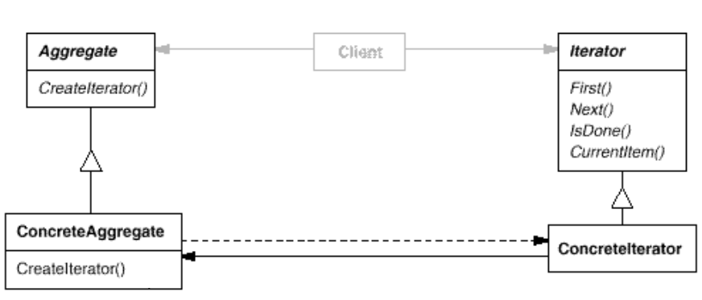
Structure

Slide 11
Participants
Iterator
defines an interface for accessing and traversing elements.
ConcreteIterator
implements the Iterator interface.
keeps track of the current position in the traversal of the aggregate.
Aggregate
defines an interface for creating an Iterator object.
ConcreteAggregate
implements the Iterator creation interface to return an instance of the proper ConcreteIterator.

Slide 12
Collaborations
A ConcreteIterator keeps track of the current object in the aggregate and can compute the succeeding object in the traversal.

Slide 13
Consequences
It supports variations in the traversal of an aggregate. (e.g. tree parsing)
Iterators simplify the Aggregate interface.
More than one traversal can be pending on an aggregate.

Slide 14
Implementation variants
External and Internal Iterator: A fundamental issue is deciding which party controls the iteration, the iterator or the client that uses the iterator. When the client controls the iteration, the iterator is called an external iterator, and when the iterator controls it, the iterator is an internal iterator.
Internal iterators are easy to use whereas external iterators are flexible.

Slide 15
Implementation variants(cont’d)
Null Iterator: A NullIterator is a degenerate iterator that's helpful for handling boundary conditions. By definition, a NullIterator is always done with traversal; that is, its IsDone operation always evaluates to true.
It can be just a cursor or it can hold algorithms.
Robust Iterator: It can be dangerous to modify an aggregate while you're traversing it. A robust iterator ensures that insertions and removals won't interfere with traversal, and it does it without copying the aggregate. There are many ways to implement robust iterators.
Polymorphic Iterators (can use factory method)
Notes:
Polymorphic Iterator: If an iterator has common contract across multiple collections, the client code which interacts with the iterator need not be changed for different collections. This is called polymorphic iterator.

Slide 16
Sample code
Iterators are not limited to traversal alone. It is entirely left to the purpose and implementation. There can be functional logic involved in an iterator. We can have a FilteringIterator, which can filter out certain required values and provide for traversal. For example in a list containing wild and domestic animals, we can have two different iterators as WildAnimalIterator and DomesticAnimalIterator.

Slide 17
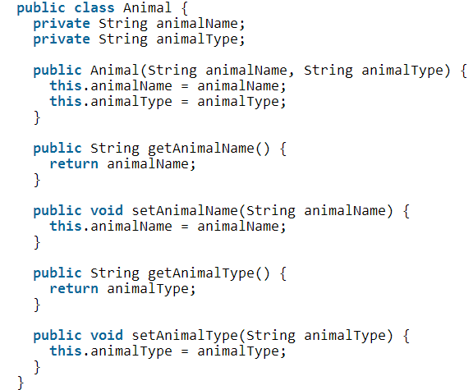
Animal.java

Slide 18
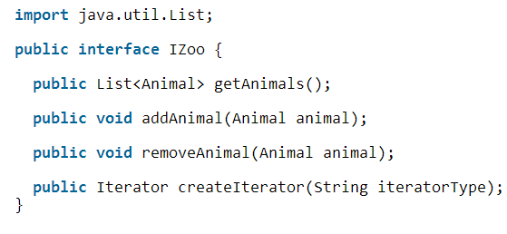
Aggregate (IZoo)

Slide 19
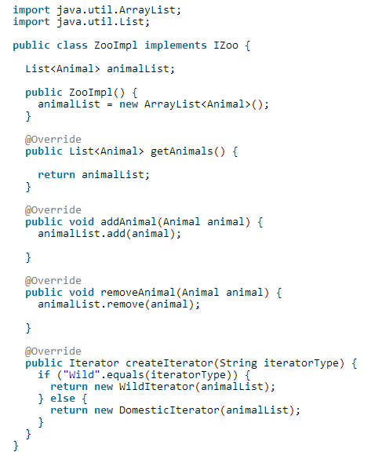
ConcreteAggregate (ZooImpl)

Slide 20
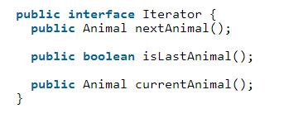
Iterator

Slide 21
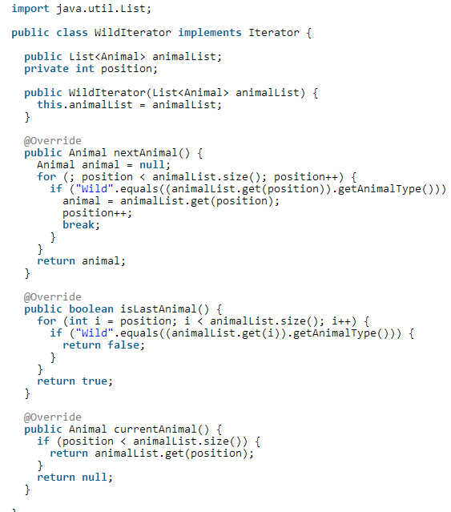
ConcreteIterator (WildIterator)

Slide 22
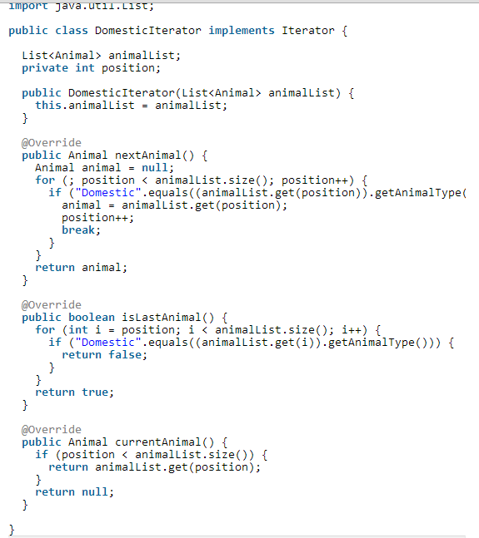
ConcreteIterator (DomesticIterator)

Slide 23
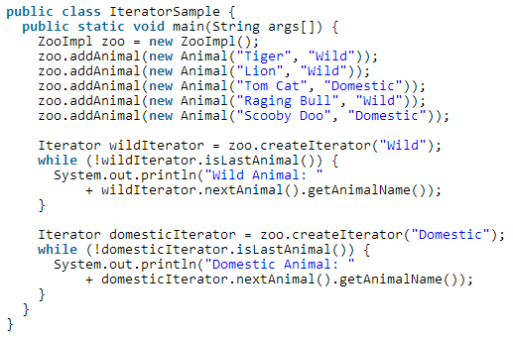
Testing Pattern

Slide 24
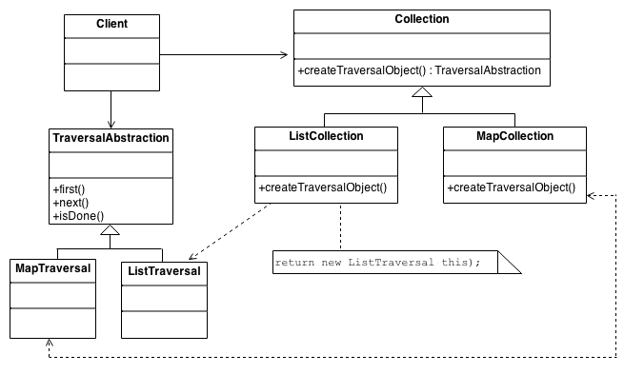
Practical # 10
OBJECT: To implement Iterator pattern for the following class diagram

